Slide 1
LESSON 1/Introduction, Part 1
Breakfast Around
the World
Oral Introduction
Keywords
Warm-up
Flash Card
Text Scroll
Paragraph
Sentence
Phrase
Summary
True or False
Check Your Understanding
Review the Contents
Paragraph Chart

Slide 2

LESSON 1/Introduction/Oral Introduction
Oral Introduction

Slide 3
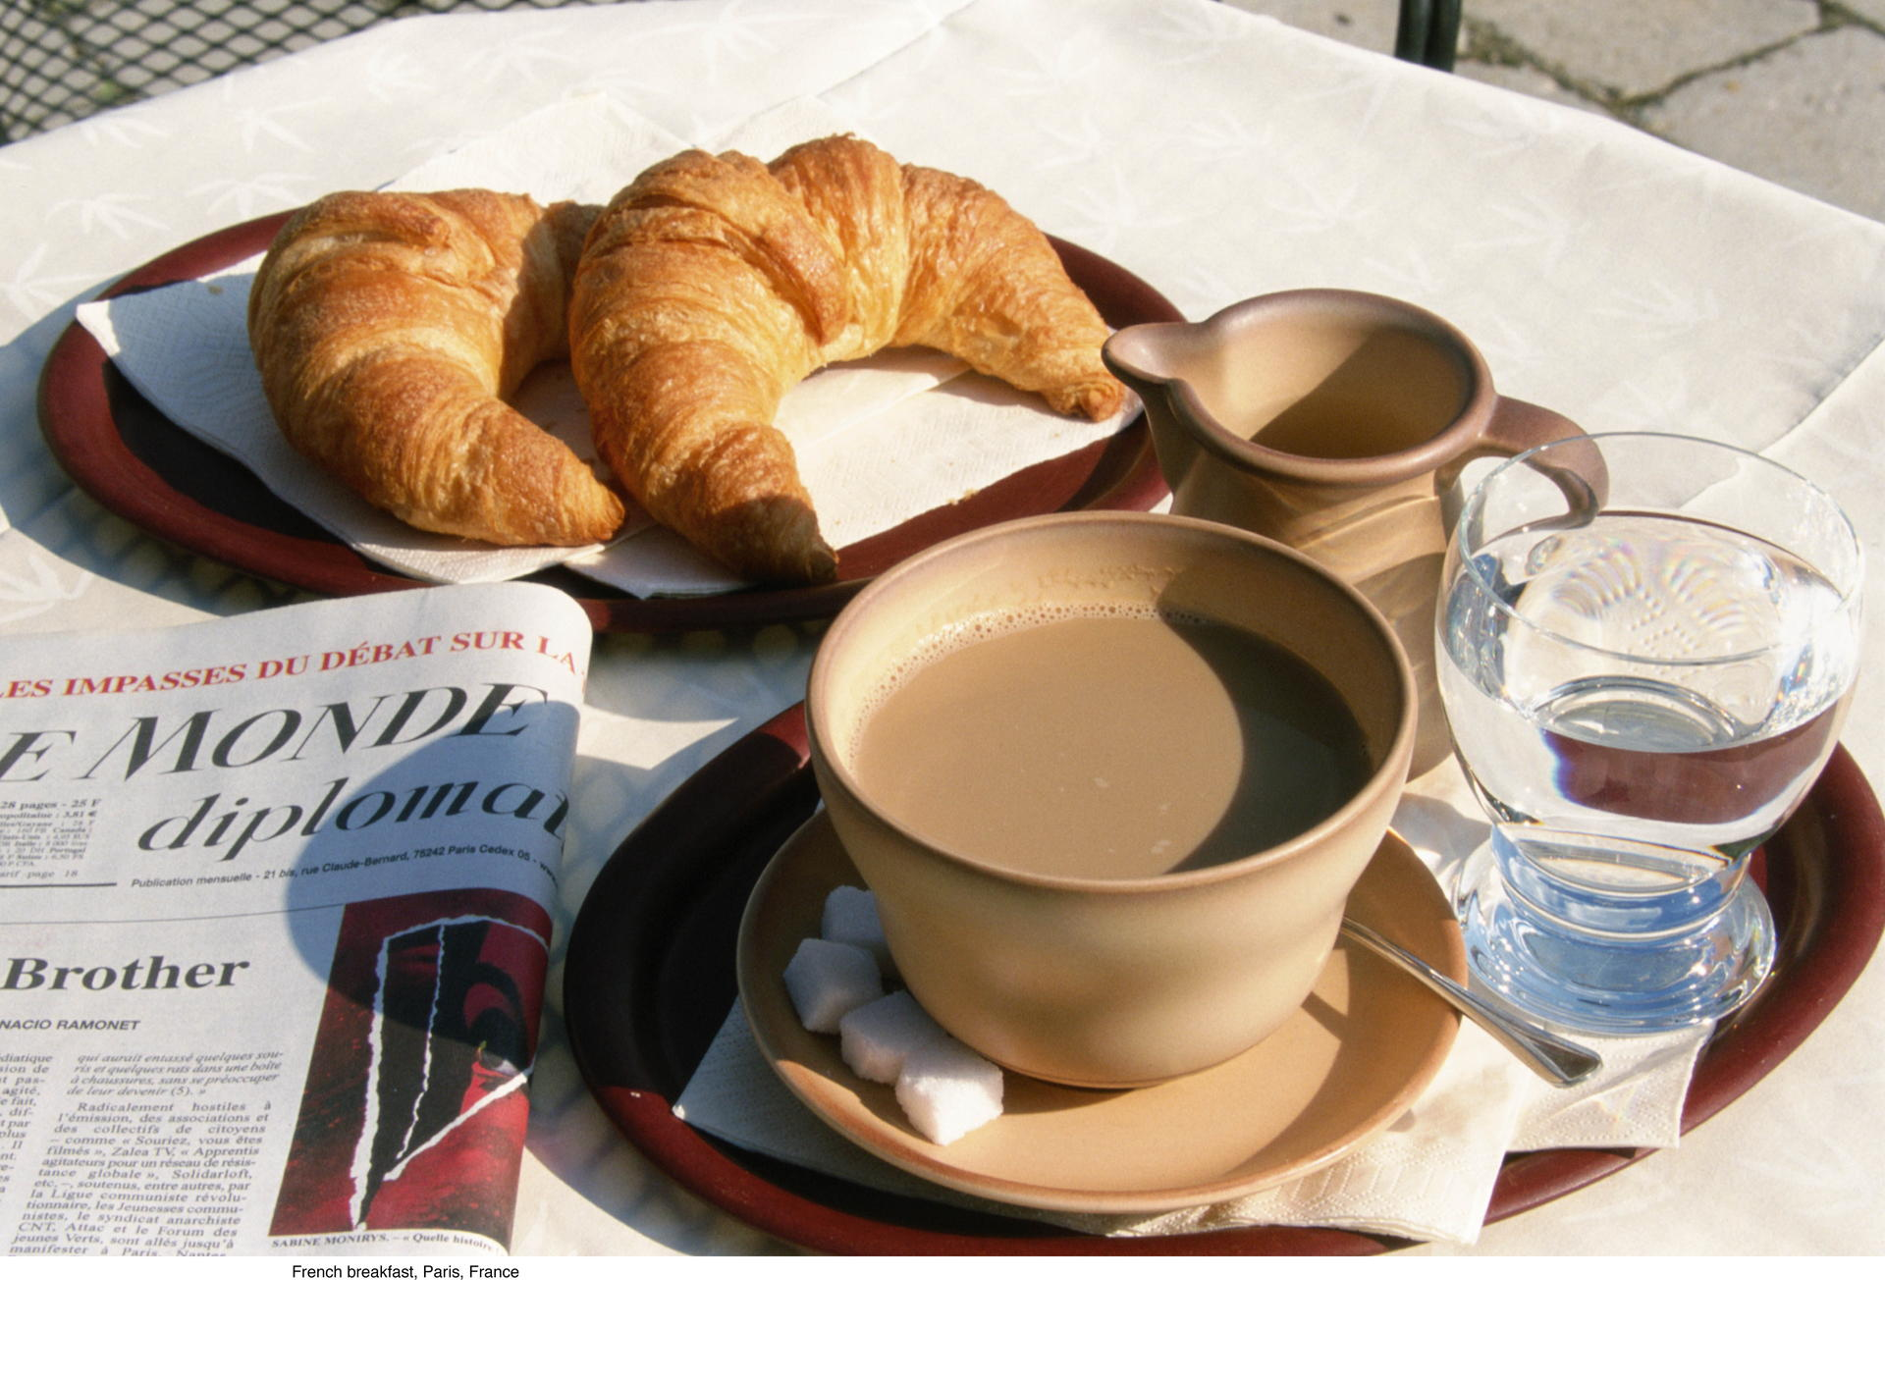

LESSON 1/Introduction/Oral Introduction
朝食は一日を活動的にいきいきと過ごすための活力の源です．
地域や文化によって朝食には特色があります．

Slide 4
LESSON 1/Introduction/Oral Introduction
Do you usually have breakfast? What do you usually eat? Breakfast is especially important, and people around the world eat various kinds of food for breakfast. It is fun to take a look at their breakfasts to see how they show us their customs and culture. In this lesson, we will compare some breakfasts from around the world.

Slide 5
LESSON 1/Introduction/Keywords
Keywords

Slide 6

LESSON 1/Introduction/Keywords
breakfast
style
custom
culture
Do you think that many Japanese still have rice and miso soup for breakfast? You might prefer bread for breakfast. This picture shows a French breakfast at a cafe. When you go abroad, you will find that each country has its own styles and customs for breakfast. Breakfast is a part of each country’s culture.

Slide 7
LESSON 1/Introduction/Warm-up
Warm-up

Slide 8
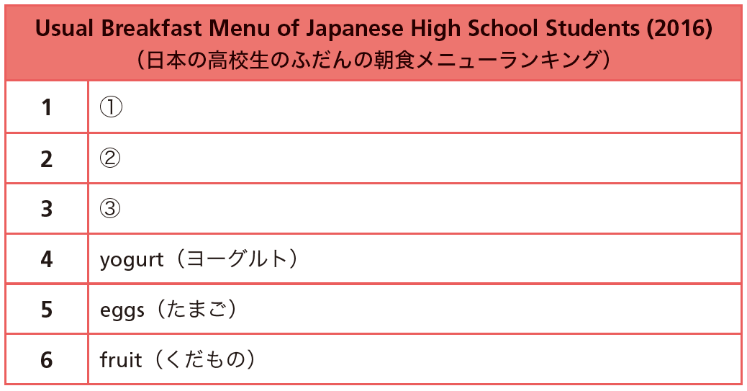
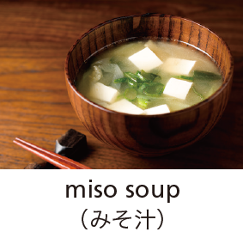
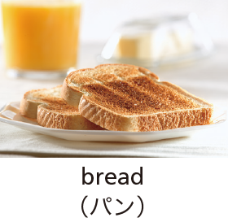
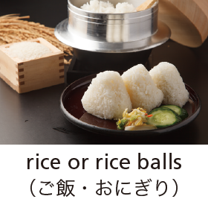
LESSON 1/Introduction/Warm-up
1. ①～③には下のどのメニューが入ると思いますか．予想しましょう．

Slide 9

LESSON 1/Introduction/Warm-up
2.音声を聞いて，予想が正しかったか確かめましょう． ①
Most Japanese prefer rice for breakfast. Some people often enjoy eating rice balls for breakfast.
rice or rice balls
Answer（ ）

Slide 10
LESSON 1/Introduction/Warm-up
2.音声を聞いて，予想が正しかったか確かめましょう． ②
Bread is not a traditional Japanese food, but it is the second most popular breakfast. It’s easy to prepare.
bread
Answer（ ）

Slide 11
LESSON 1/Introduction/Warm-up
2.音声を聞いて，予想が正しかったか確かめましょう． ③
The third most popular dish is miso soup. You can add things you like such as vegetables, mushrooms, and tofu.
miso soup
Answer（ ）

Slide 12
LESSON 1/Part 1/Flash Card
Flash Card

Slide 13
名
smoothie

Slide 14
名
スムージー

Slide 15

名

Slide 16
名
inn

Slide 17
名
旅 館

Slide 18

名

Slide 19
形
coastal

Slide 20
形
沿 岸 の

Slide 21

形

Slide 22
名
resort

Slide 23
名
リゾート地,行楽地

Slide 24

名

Slide 25
名
seafood

Slide 26
名
魚 介 類

Slide 27

名

Slide 28
動
differ

Slide 29
動
異 な る

Slide 30

動

Slide 31
LESSON 1/Part 1/Text Scroll
Text Scroll

Slide 32

LESSON 1/Part 1/Text Scroll
Did you have breakfast this morning? Our morning schedules are tight, so some people only drink a smoothie or juice. Breakfast is your energy source for an active day.
Breakfast means something special when we travel. Hotels or inns serve a delicious breakfast with local food. If you visit a coastal resort, you can enjoy fish or seafood. When you stay at a mountain resort, you can enjoy delicious wild plants and mushrooms.
Breakfast differs from place to place and from country to country. Let’s take a look at some examples of breakfasts from around the world.

Slide 33
LESSON 1/Part 1/Paragraph
Paragraph

Slide 34
LESSON 1/Part 1/Paragraph
Did you have breakfast this morning? Our morning schedules are tight, so some people only drink a smoothie or juice. Breakfast is your energy source for an active day.

Slide 35
LESSON 1/Part 1/Paragraph
Breakfast means something special when we travel. Hotels or inns serve a delicious breakfast with local food. If you visit a coastal resort, you can enjoy fish or seafood. When you stay at a mountain resort, you can enjoy delicious wild plants and mushrooms.

Slide 36
LESSON 1/Part 1/Paragraph
Breakfast differs from place to place and from country to country. Let’s take a look at some examples of breakfasts from around the world.

Slide 37
LESSON 1/Part 1/Sentence
Sentence

Slide 38
LESSON 1/Part 1/Sentence
Did you have breakfast this morning?

Slide 39
LESSON 1/Part 1/Sentence
Our morning schedules are tight, so some
people only drink a smoothie or juice.

Slide 40
LESSON 1/Part 1/Sentence
Breakfast is your energy source for an active
day.

Slide 41
LESSON 1/Part 1/Sentence
Breakfast means something special when we
travel.

Slide 42
LESSON 1/Part 1/Sentence
Hotels or inns serve a delicious breakfast with
local food.

Slide 43
LESSON 1/Part 1/Sentence
If you visit a coastal resort, you can enjoy fish
or seafood.

Slide 44
LESSON 1/Part 1/Sentence
When you stay at a mountain resort, you can
enjoy delicious wild plants and mushrooms.

Slide 45
LESSON 1/Part 1/Sentence
Breakfast differs from place to place and from
country to country.

Slide 46
LESSON 1/Part 1/Sentence
Let’s take a look at some examples of
breakfasts from around the world.

Slide 47
LESSON 1/Part 1/Phrase
Phrase

Slide 48

LESSON 1/Part 1/Phrase
Did you have breakfast this morning?
けさ朝食をとりましたか

Slide 49

LESSON 1/Part 1/Phrase
Our morning schedules are tight, so some
people only drink a smoothie or juice.
/
朝のスケジュールは余裕がない
それでスムージーやジュースを飲むだけという人もいます

Slide 50
LESSON 1/Part 1/Phrase
Breakfast is your energy source for an active
day.
/
朝食はエネルギー源です 活動的な1日のための

Slide 51
LESSON 1/Part 1/Phrase
Breakfast means something special
when we travel.
/
朝食は特別なものを意味します
旅行しているときには

Slide 52
LESSON 1/Part 1/Phrase
Hotels or inns serve a delicious breakfast with
local food.
ホテルや旅館は，その土地の食材を使ったおいしい朝食を提供します

Slide 53
LESSON 1/Part 1/Phrase
If you visit a coastal resort,
you can enjoy fish or seafood.
/
あなたが海辺のリゾート地を訪れれば
新鮮な魚介類を楽しむことができます

Slide 54
LESSON 1/Part 1/Phrase
When you stay at a mountain resort, you can
enjoy delicious wild plants and mushrooms.
/
あなたが山のリゾートに滞在しているなら
おいしい山菜やキノコを楽しむことができます

Slide 55
LESSON 1/Part 1/Phrase
Breakfast differs from place to place
and from country to country.
/
朝食は場所によって異なります
また国によって

Slide 56
LESSON 1/Part 1/Phrase
Let’s take a look at some examples of
breakfasts from around the world.
朝食の例をいくつか見てみましょう
/
世界中から

Slide 57
LESSON 1/Part 1/Summary
Summary

Slide 58
LESSON 1/Part 1/Summary

Slide 59
LESSON 1/Part 1/Summary
Breakfast is important. It gives us energy for the day. Some people have a simple breakfast when they are busy. Breakfast is different from place to place and (from) country to country. Wherever you go, you can enjoy a local breakfast with food that is grown locally.

Slide 60
LESSON 1/Part 1/True or False
True or False

Slide 61
LESSON 1/Part 1/True or False
True or False ①
Some people only drink a smoothie or juice for breakfast because they are busy in the morning.
Answer（ ）
T

Slide 62
LESSON 1/Part 1/True or False
True or False ②
When you visit a coastal resort, you’ll be served wild plants and mushrooms.
Answer（ ）
F

Slide 63
LESSON 1/Part 1/True or False
True or False ③
Breakfast is the same everywhere.
F
Answer（ ）

Slide 64
LESSON 1/Part 1/Check Your Understanding
Check Your Understanding

Slide 65
LESSON 1/Part 1/Check Your Understanding
ペアになって，本文の内容について質問しあいましょう． ①
Is breakfast the same everywhere?
No, it isn’t. Breakfast differs from place to
place (and from country to country).

Slide 66
LESSON 1/Part 1/Check Your Understanding
ペアになって，本文の内容について質問しあいましょう． ②
What do some people have for breakfast when they are busy in the morning?
They only drink a smoothie or juice.

Slide 67
LESSON 1/Part 1/Check Your Understanding
ペアになって，本文の内容について質問しあいましょう． ③
What can you enjoy for breakfast when staying at a mountain resort?
We can enjoy delicious wild plants and
mushrooms.

Slide 68
LESSON 1/Part 1/Review the Contents
Review the Contents

Slide 69
LESSON 1/Part 1/Review the Contents
本文の内容に合うように，かっこの中に適当な語を入れて読みましょう． ①
Breakfast is the （ ） of energy for an active day.
source

Slide 70
LESSON 1/Part 1/Review the Contents
本文の内容に合うように，かっこの中に適当な語を入れて読みましょう． ②
Breakfast means something （ ） when we travel.
special

Slide 71
LESSON 1/Part 1/Review the Contents
本文の内容に合うように，かっこの中に適当な語を入れて読みましょう． ③
You can eat fish or（ ） when you are staying at a coastal resort.
seafood

Slide 72
LESSON 1/Part 1/Paragraph Chart
Paragraph Chart

Slide 73



LESSON 1/Part 1/Paragraph Chart
energy source
Breakfast is our ( ) for an active day.
Breakfast differs from place to place.
・At a coastal resort,
we can eat ( ) or ( ).
・At a mountain resort,
we can eat wild ( ) and ( ).
fish
seafood
plants
mushrooms

Slide 74
LESSON 1/Part 1/Paragraph Chart
朝食は活動的な一日のエネルギー源。
朝食は場所によって異なる。
・海辺のリゾートでは、
魚や魚介類を食べることができる
・山岳リゾートでは、
山菜(野生の植物)やキノコを食べることができる

